Slide 1


Azərbaycan Dövlət Neft və Sənaye Universiteti
Calculus
Single Variable

Slide 2
Numerical Integration

Slide 3
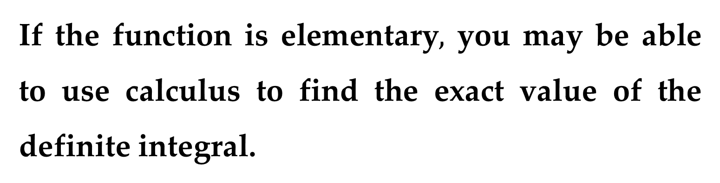
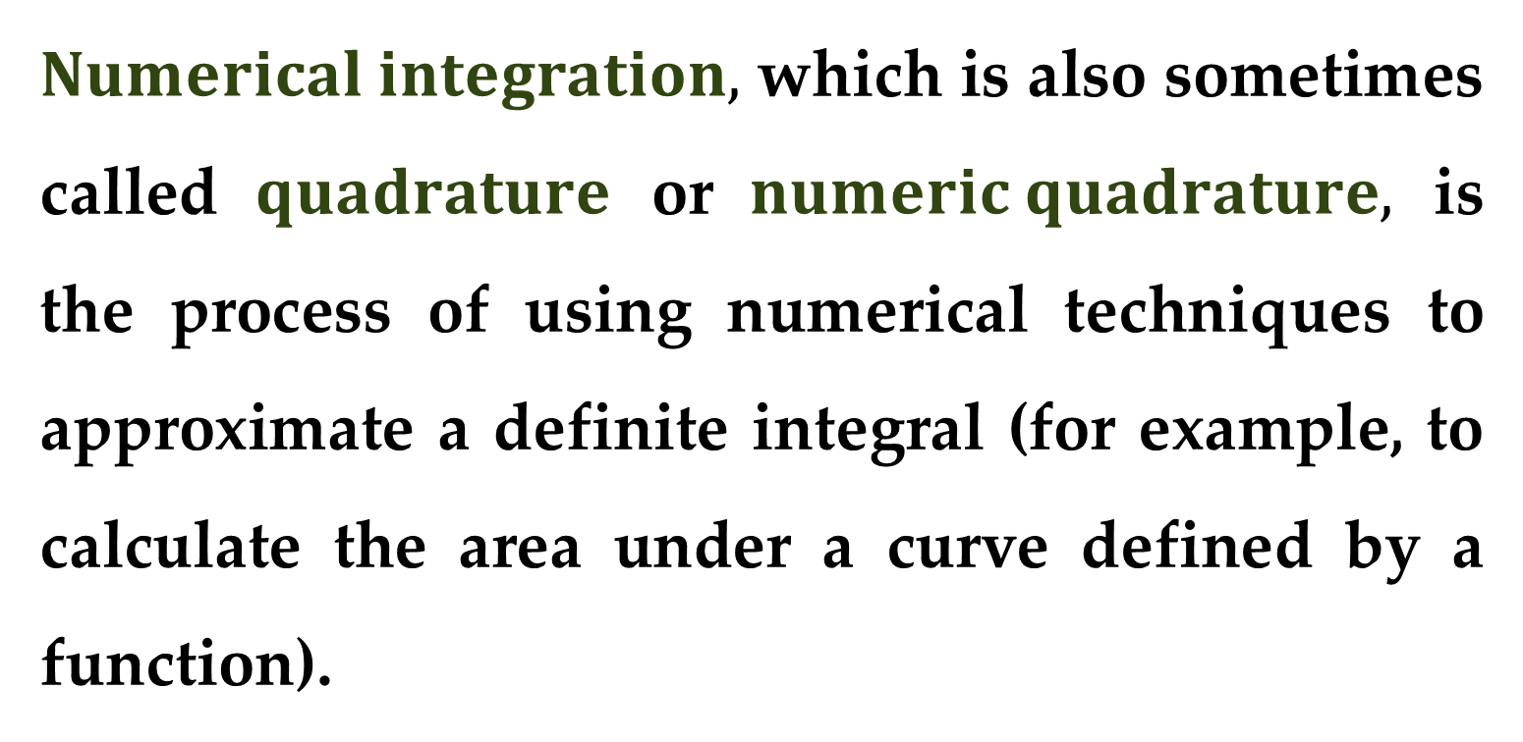
$Numerical integration,$ which is also sometimes called $quadrature$ or $numeric quadrature,$ is the process of using numerical techniques to approximate a definite integral (for example, to calculate the area under a curve defined by a function).
If the function is elementary$,$ you may be able to use calculus to find the exact value of the definite integral.

Slide 4
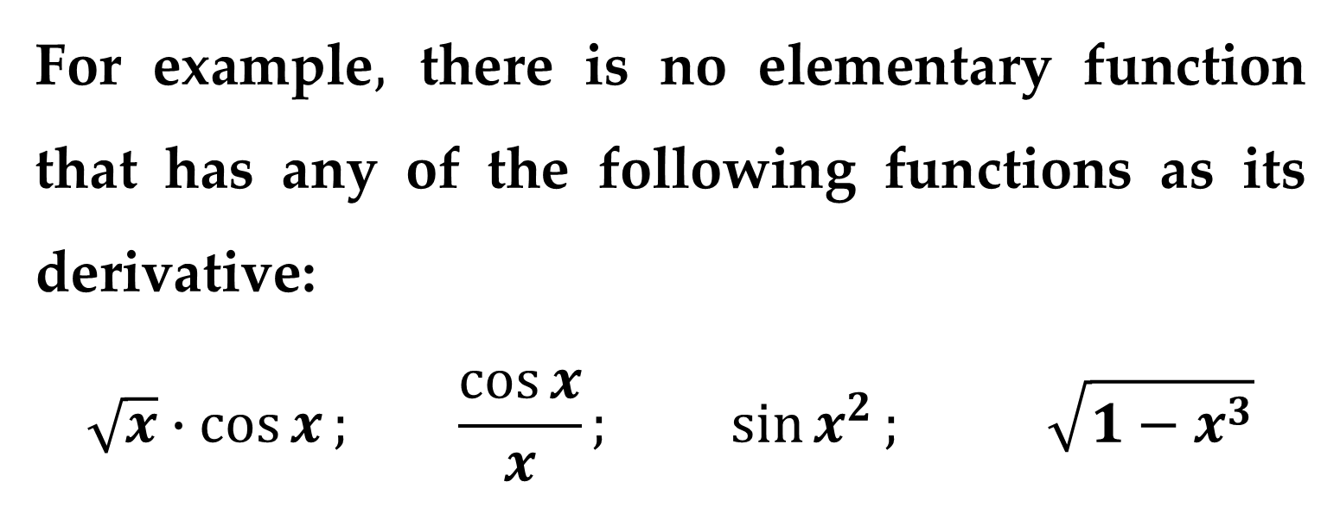
Some elementary functions simply do not have antiderivatives that are elementary functions.
For example$,$ there is no elementary function that has any of the following functions as its derivative:
$$\sqrt{x}∙\cos{x}; \frac{\cos{x}}{x}; \sin{x^{2}}; \sqrt{1−x^{3}}$$

Slide 5
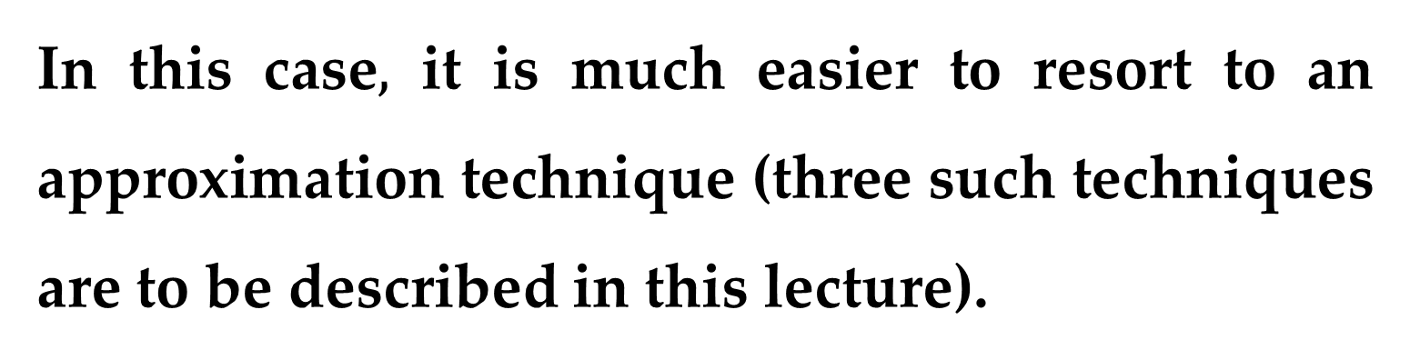
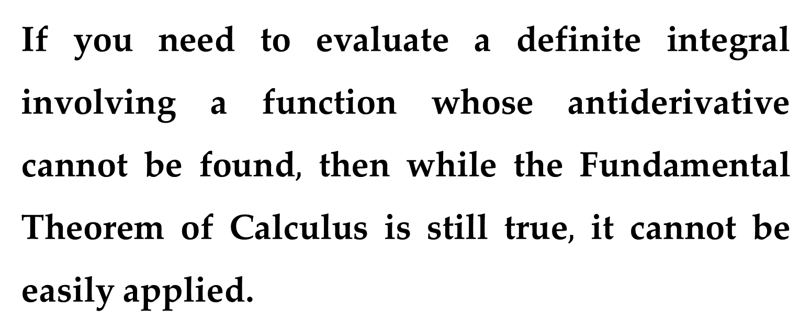
If you need to evaluate a definite integral involving a function whose antiderivative cannot be found$,$ then while the Fundamental Theorem of Calculus is still true$,$ it cannot be easily applied.
In this case$,$ it is much easier to resort to an approximation technique (three such techniques are to be described in this lecture).

Slide 6

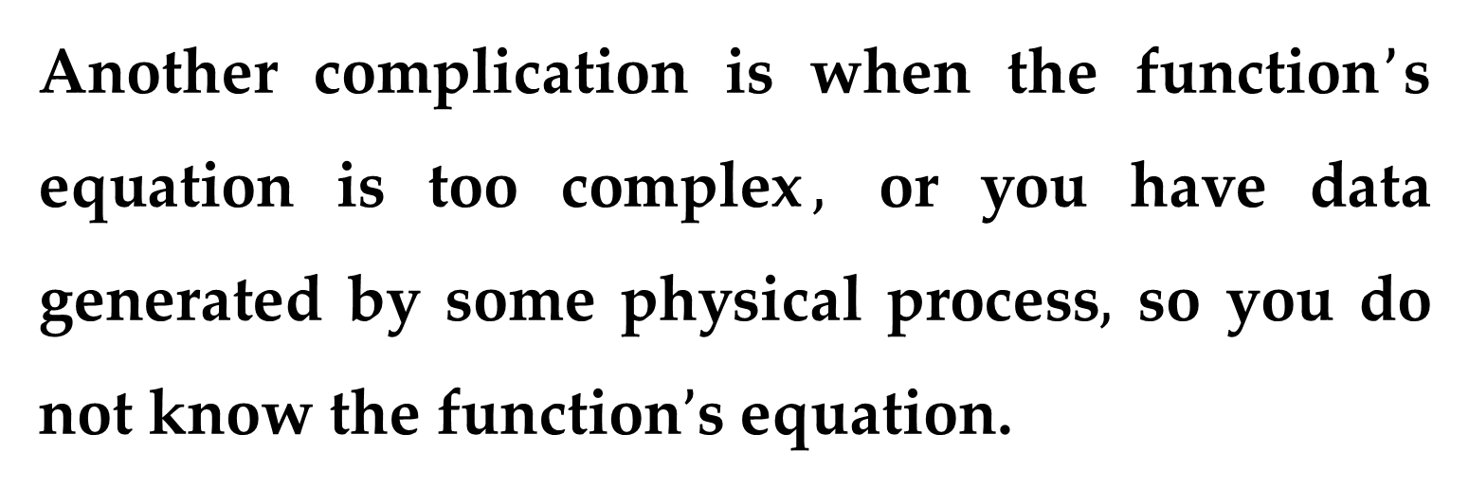
Another complication is when the function$’$s equation is too complex$,$ or you have data generated by some physical process$,$ so you do not know the function$’$s equation.
In this case$,$ again$,$ you cannot use calculus$,$ but you can use numerical integration.
There are several ways to perform numerical integration.

Slide 7
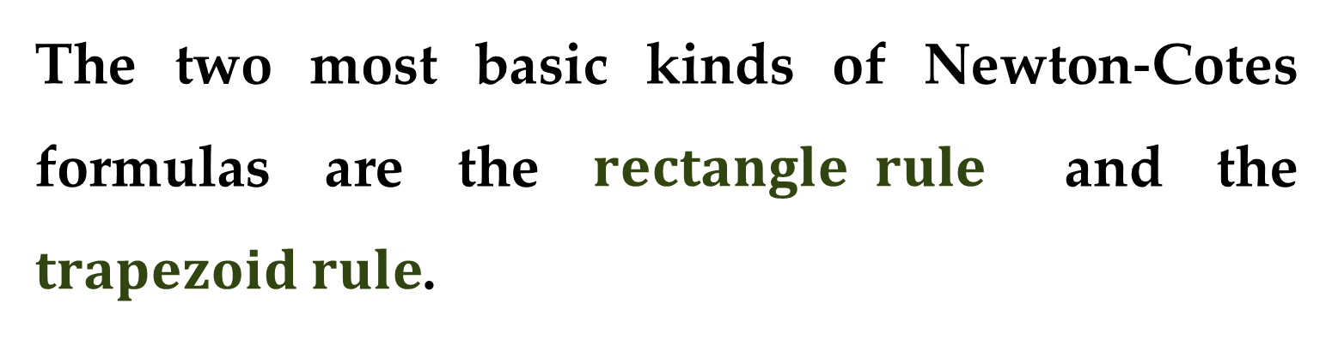
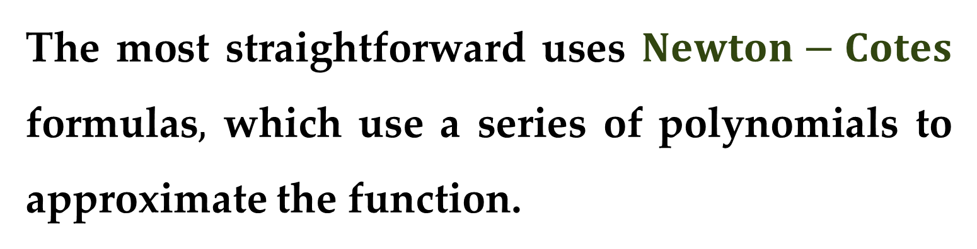
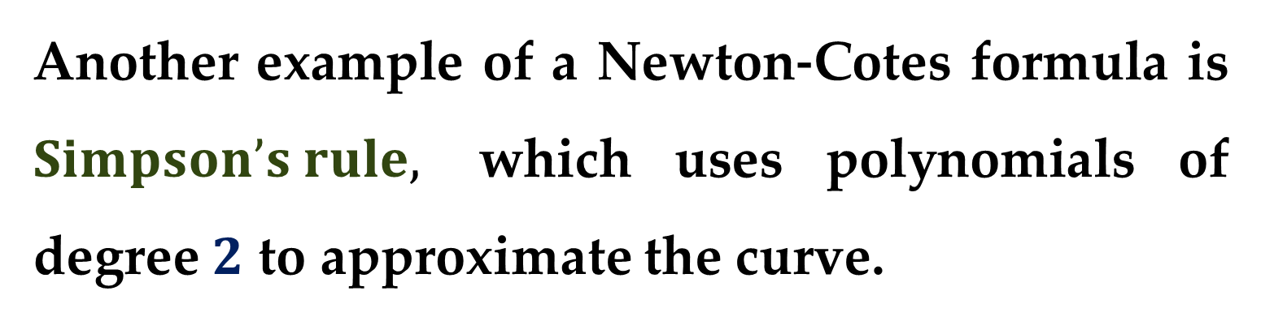
The most straightforward uses $Newton−Cotes$ formulas$,$ which use a series of polynomials to approximate the function.
The two most basic kinds of Newton-Cotes formulas are the $rectangle rule$ and the $trapezoid rule$.
Another example of a Newton-Cotes formula is $Simpson’s rule,$ which uses polynomials of degree $2$ to approximate the curve.

Slide 8
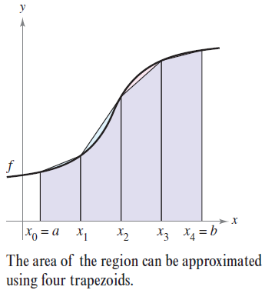
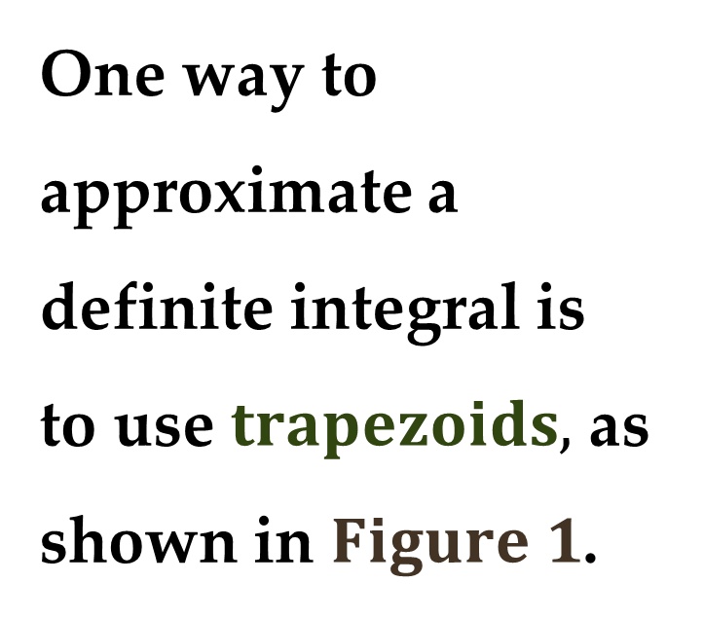
Other methods use polynomials of even higher degree to make better approximations of the curve.
One way to approximate a definite integral is to use $trapezoids,$ as shown in $Figure 1$.

Slide 9
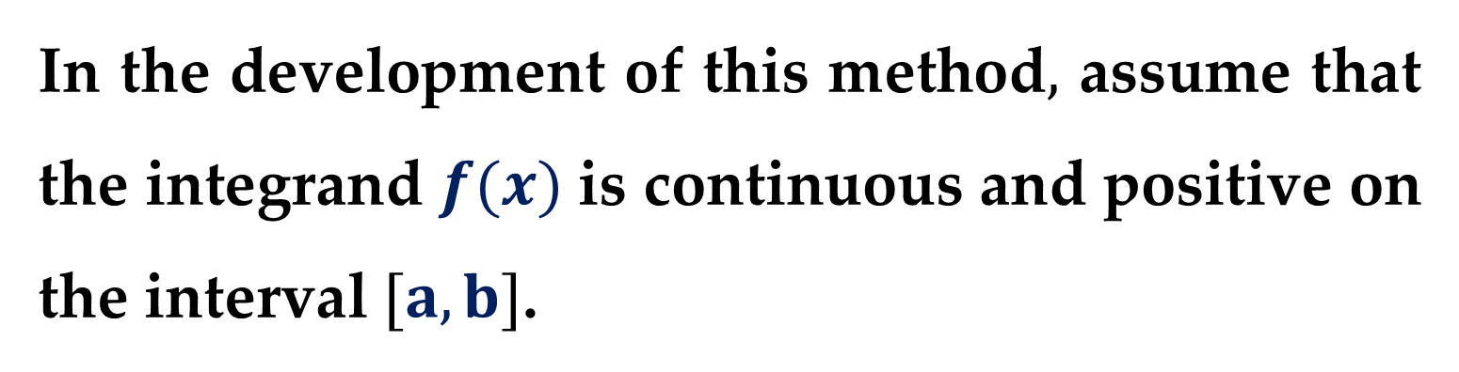
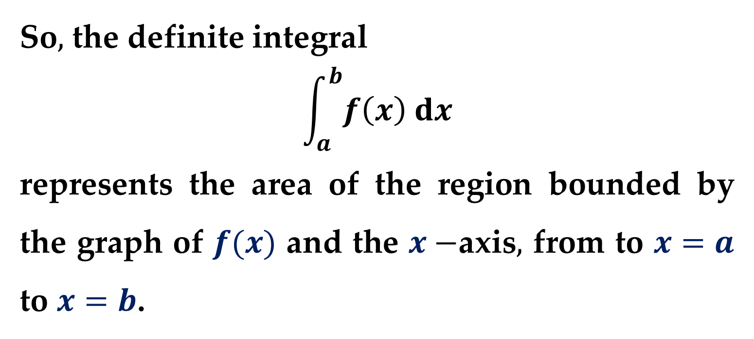
In the development of this method$,$ assume that the integrand $f(x)$ is continuous and positive on the interval $[a,b]$.
So$,$ the definite integral
$$\int_{a}^{b}{f\left(x\right) dx}$$
represents the area of the region bounded by the graph of $f(x)$ and the $x−$axis$,$ from to $x=a$ to $x=b$.

Slide 10
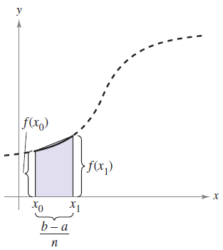
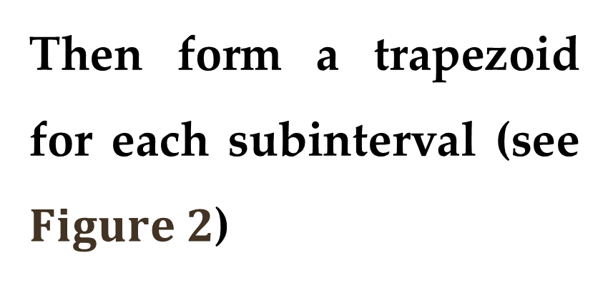
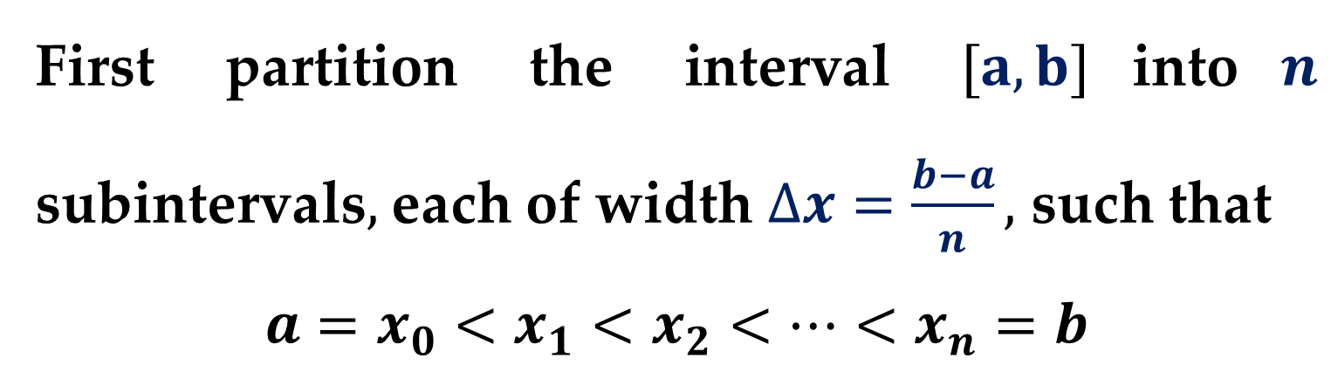
First partition the interval $[a,b]$into$n$ subintervals$,$ each of width $∆x=\frac{b−a}{n},$ such that
$$a=x_{0}<x_{1}<x_{2}<…<x_{n}=b$$
Then form a trapezoid for each subinterval (see $Figure 2$)

Slide 11
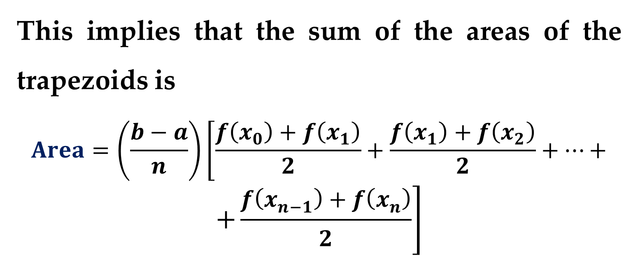
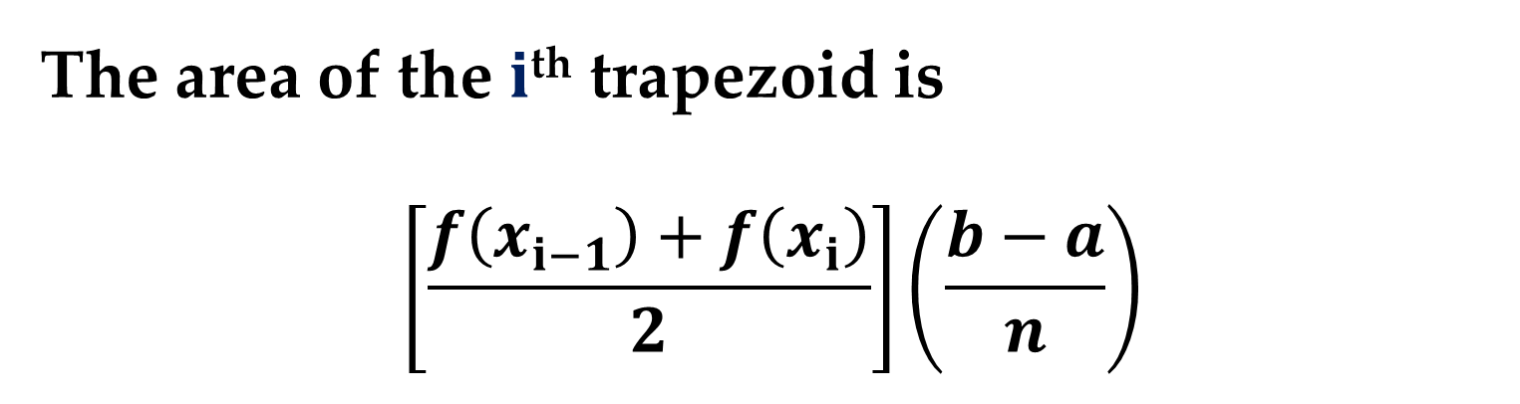
The area of the $i$^{th} trapezoid is
$$\left[\frac{f\left(x_{i−1}\right)+f\left(x_{i}\right)}{2}\right]\left(\frac{b−a}{n}\right)$$
This implies that the sum of the areas of the trapezoids is
$$Area=\left(\frac{b−a}{n}\right)\left[\frac{f\left(x_{0}\right)+f\left(x_{1}\right)}{2}+\frac{f\left(x_{1}\right)+f\left(x_{2}\right)}{2}+…+\right.$$
$$\left.+\frac{f\left(x_{n−1}\right)+f\left(x_{n}\right)}{2}\right]$$

Slide 12
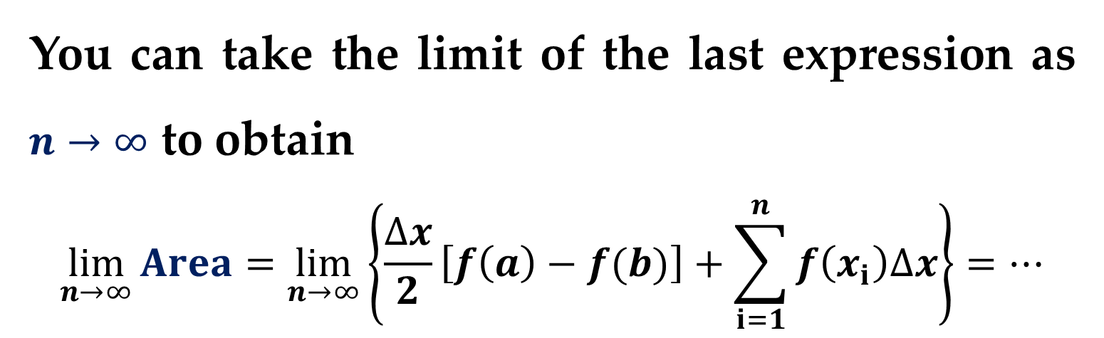
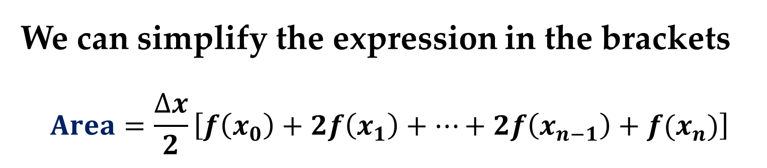
We can simplify the expression in the brackets
$$Area=\frac{∆x}{2}\left[f\left(x_{0}\right)+2f\left(x_{1}\right)+…+2f\left(x_{n−1}\right)+f(x_{n})\right]$$
You can take the limit of the last expression as $n→∞$ to obtain
$$\lim_{n→∞}{Area}=\lim_{n→∞}\left\{\frac{∆x}{2}\left[f\left(a\right)−f(b)\right]+\sum_{i=1}^{n}{f\left(x_{i}\right)∆x}\right\}=…$$

Slide 13
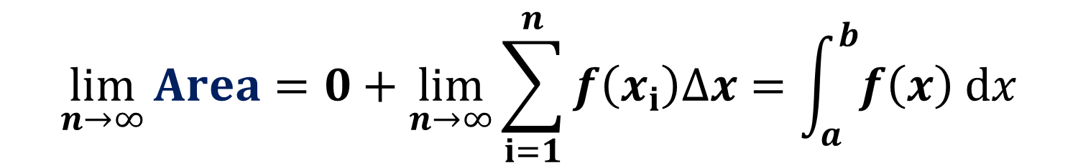
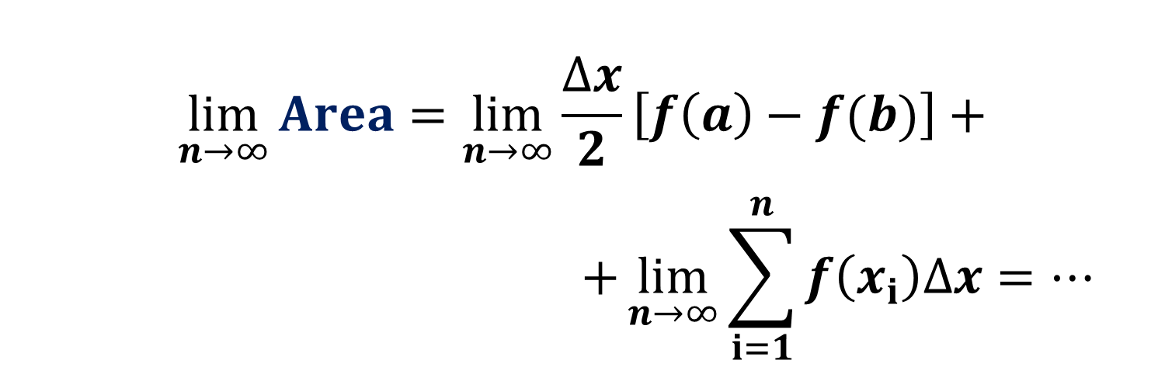
$$\lim_{n→∞}{Area}=\lim_{n→∞}{\frac{∆x}{2}\left[f\left(a\right)−f(b)\right]}+$$
$$+\lim_{n→∞}{\sum_{i=1}^{n}{f\left(x_{i}\right)∆x}}=…$$
$$\lim_{n→∞}{Area}=0+\lim_{n→∞}{\sum_{i=1}^{n}{f\left(x_{i}\right)∆x}}=\int_{a}^{b}{f\left(x\right) dx}$$
The result is summarized in the following theorem.

Slide 14
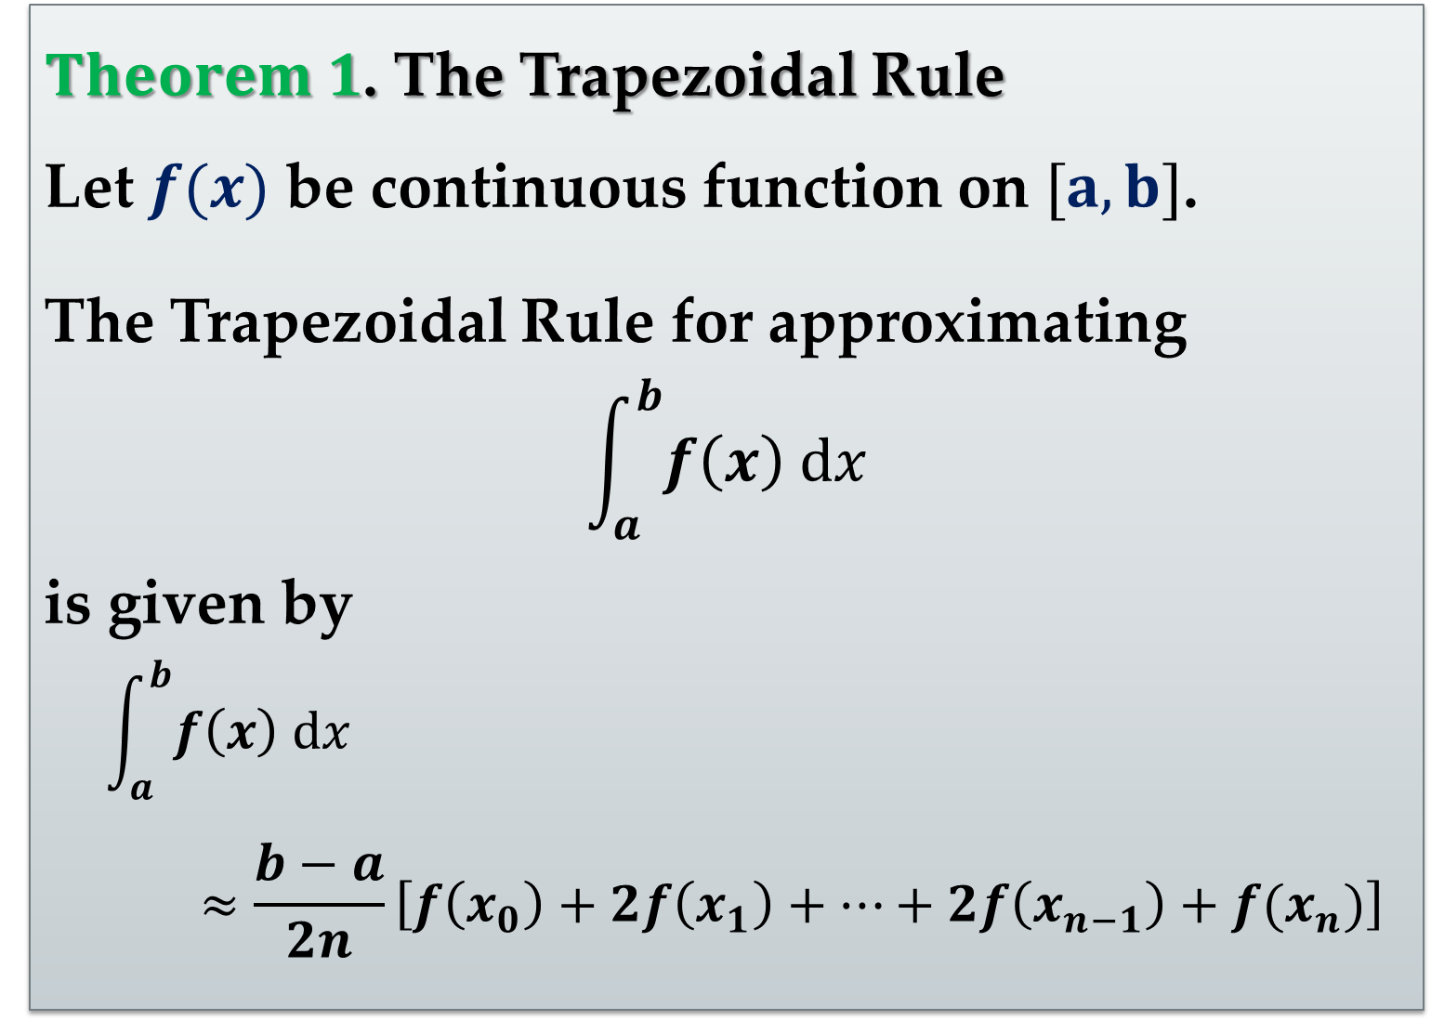
$Theorem 1$. The Trapezoidal Rule
Let $f(x)$ be continuous function on $[a,b]$.
The Trapezoidal Rule for approximating
$$\int_{a}^{b}{f\left(x\right) dx}$$
is given by
$$\int_{a}^{b}{f\left(x\right) dx}$$
$$≈\frac{b−a}{2n}\left[f\left(x_{0}\right)+2f\left(x_{1}\right)+…+2f\left(x_{n−1}\right)+f(x_{n})\right]$$

Slide 15
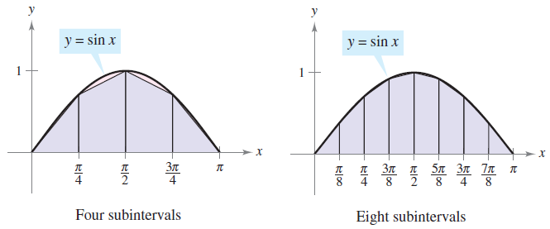
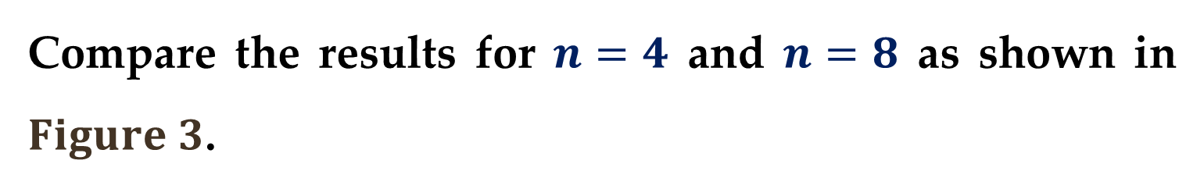
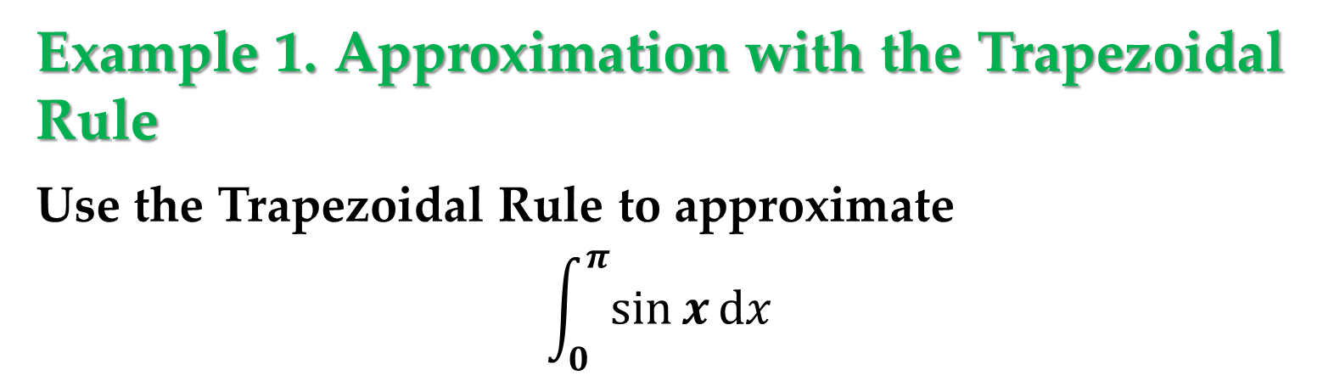
Example 1. Approximation with the Trapezoidal Rule
Use the Trapezoidal Rule to approximate
$$\int_{0}^{π}{\sin{x}dx}$$
Compare the results for $n=4$ and $n=8$ as shown in $Figure 3$.

Slide 16
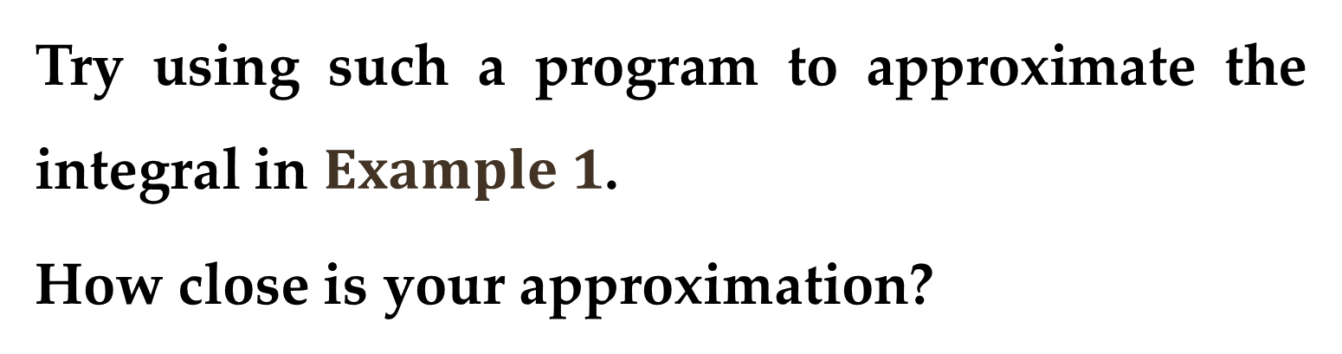
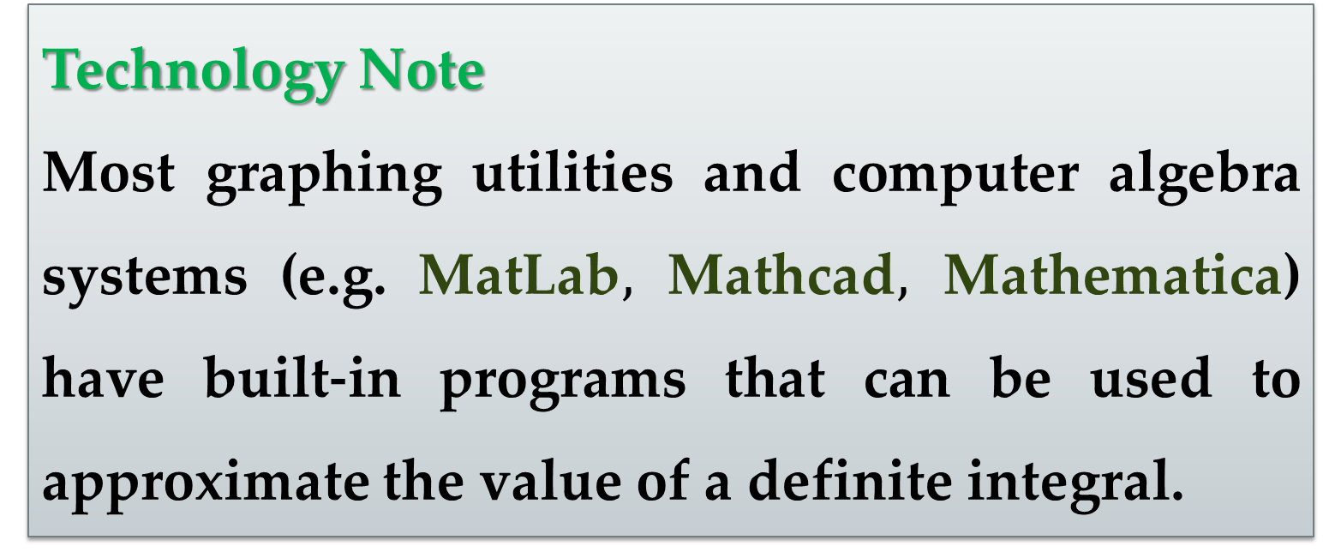
Technology Note
Most graphing utilities and computer algebra systems (e.g. MatLab$,$ Mathcad$,$ Mathematica) have built-in programs that can be used to approximate the value of a definite integral.
Try using such a program to approximate the integral in $Example 1$.
How close is your approximation?

Slide 17
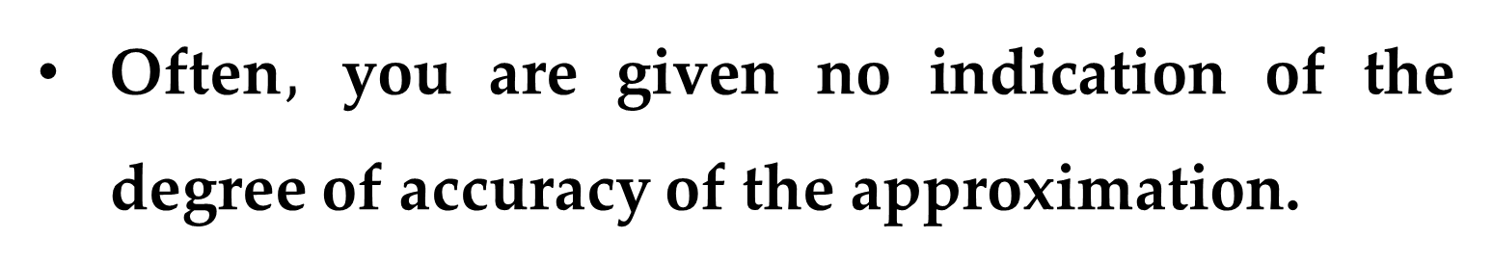

When you use such a program$,$ you need to be aware of its limitations:
Often$,$ you are given no indication of the degree of accuracy of the approximation.
Other times, you may be given an approximation that is completely wrong.

Slide 18
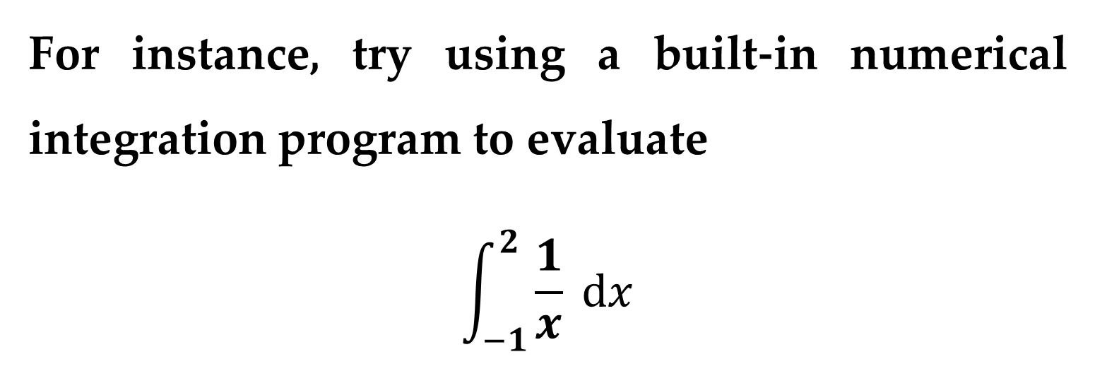
For instance, try using a built-in numerical integration program to evaluate
$$\int_{−1}^{2}{\frac{1}{x} dx}$$
Good calculator should give an error message. But does yours?

Slide 19
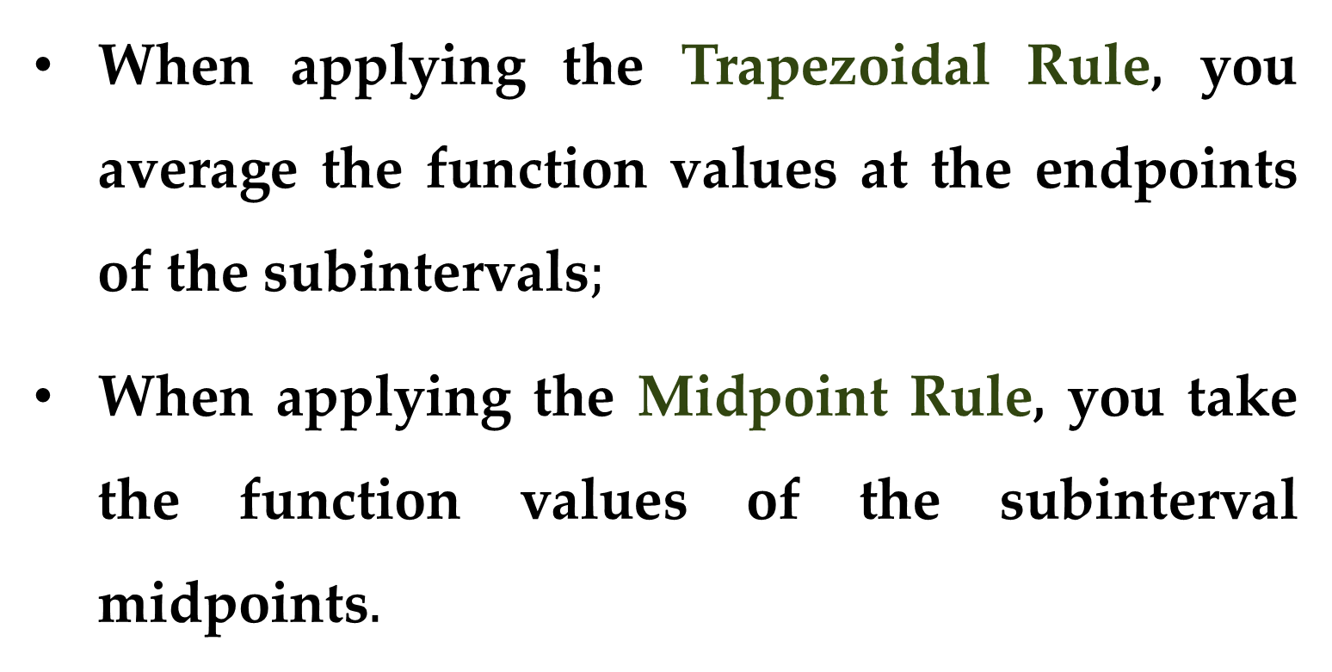
It is interesting to compare the Trapezoidal Rule with the Midpoint Rule.
When applying the Trapezoidal Rule, you average the function values at the endpoints of the subintervals$;$
When applying the Midpoint Rule, you take the function values of the subinterval midpoints$.$

Slide 20
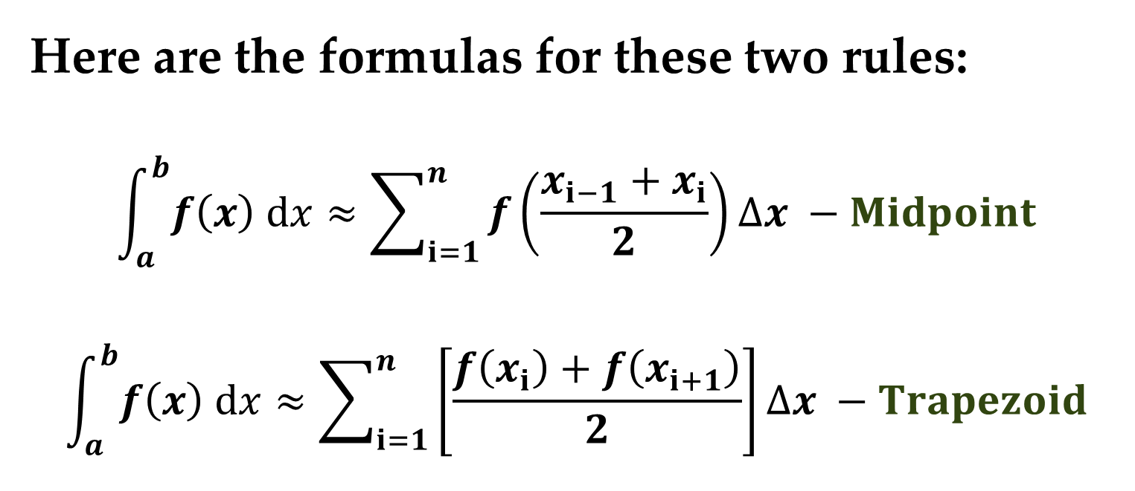
Here are the formulas for these two rules:
$$\int_{a}^{b}{f\left(x\right) dx}≈\sum_{i=1}^{n}{f\left(\frac{x_{i−1}+x_{i}}{2}\right)∆x} −Midpoint$$
$$\int_{a}^{b}{f\left(x\right) dx}≈\sum_{i=1}^{n}{\left[\frac{f\left(x_{i}\right)+f\left(x_{i+1}\right)}{2}\right]∆x} −Trapezoid$$

Slide 21
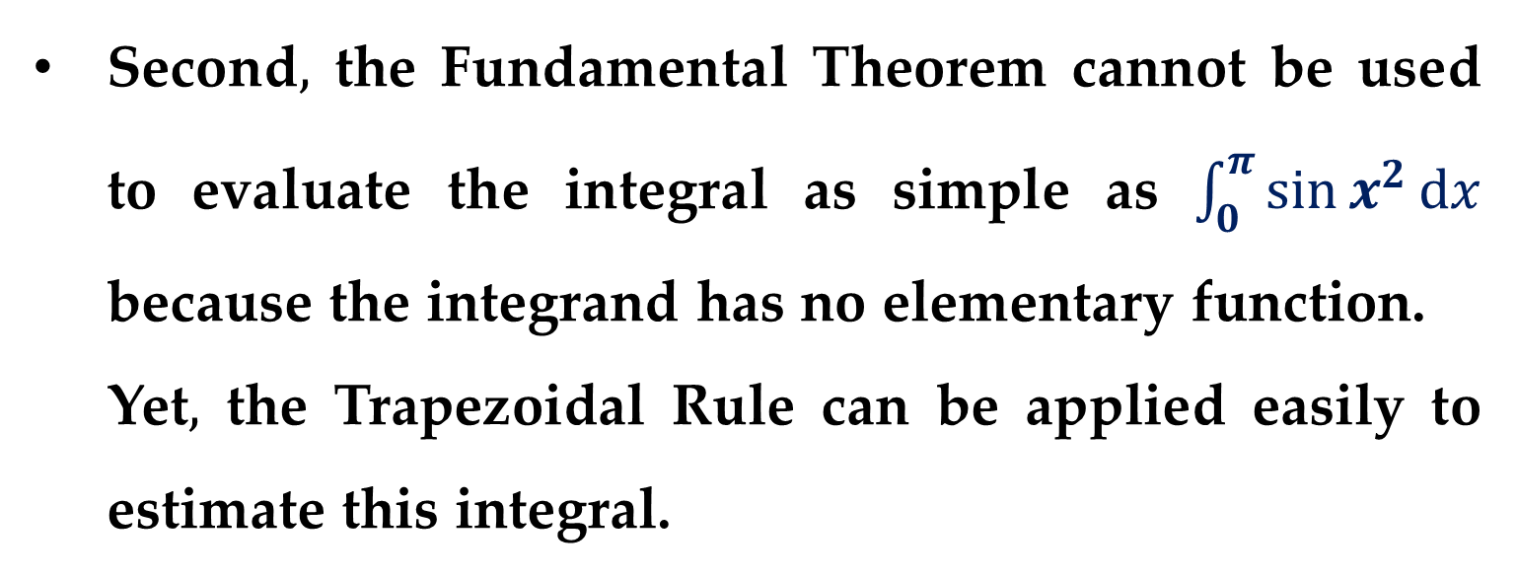
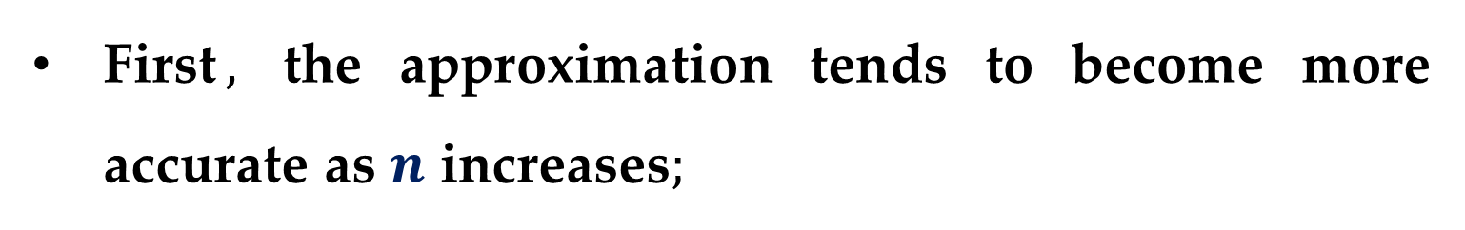
Remarks
There are two important points that should be made concerning the Trapezoidal Rule (or Midpoint Rule).
First$,$ the approximation tends to become more accurate as $n$ increases$;$
Second$,$ the Fundamental Theorem cannot be used to evaluate the integral as simple as $\int_{0}^{π}{\sin{x^{2}}dx}$ because the integrand has no elementary function.
Yet$,$ the Trapezoidal Rule can be applied easily to estimate this integral.

Slide 22
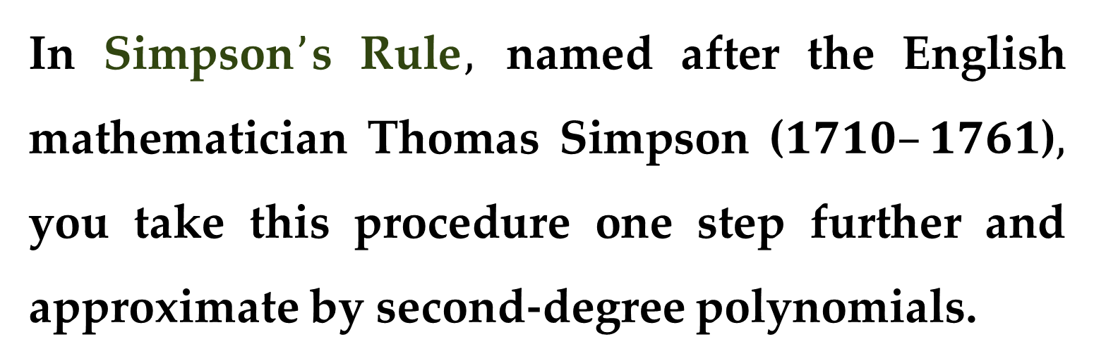
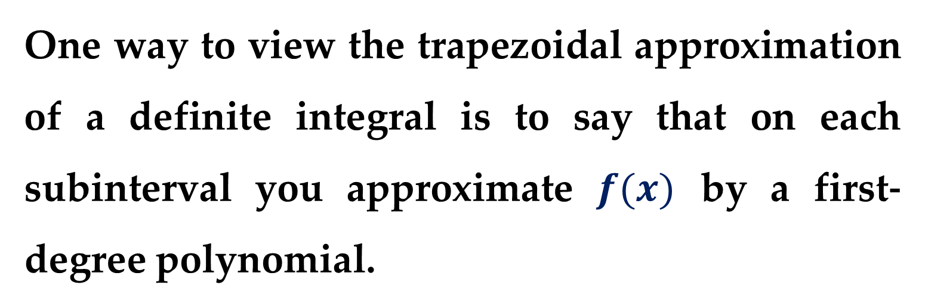
One way to view the trapezoidal approximation of a definite integral is to say that on each subinterval you approximate $f(x)$ by a first-degree polynomial.
In Simpson$’$s Rule$,$ named after the English mathematician Thomas Simpson ($1710–1761$)$,$ you take this procedure one step further and approximate by second-degree polynomials.

Slide 23
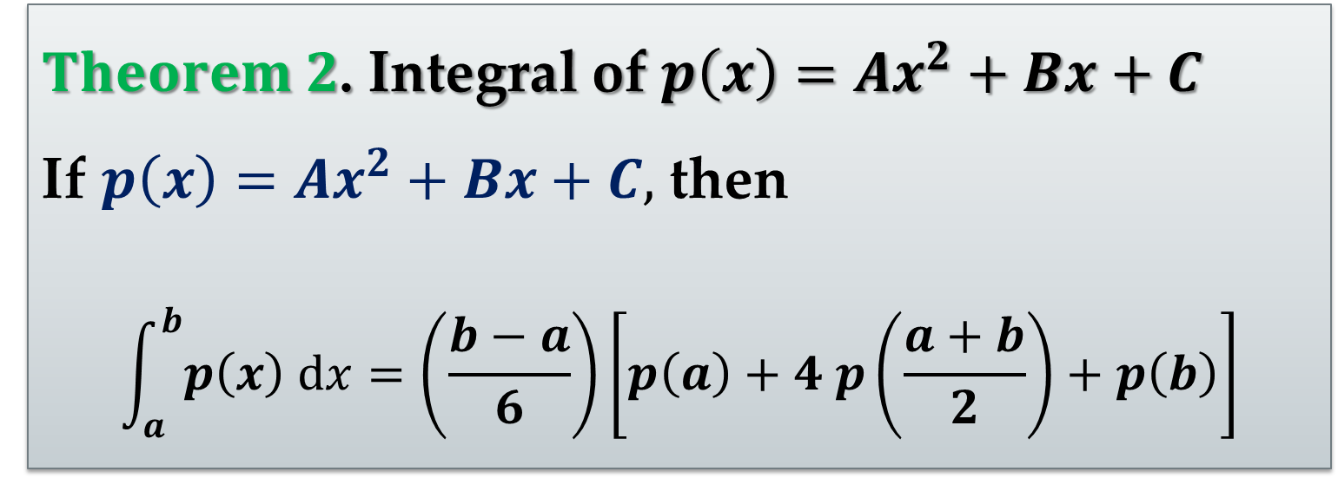
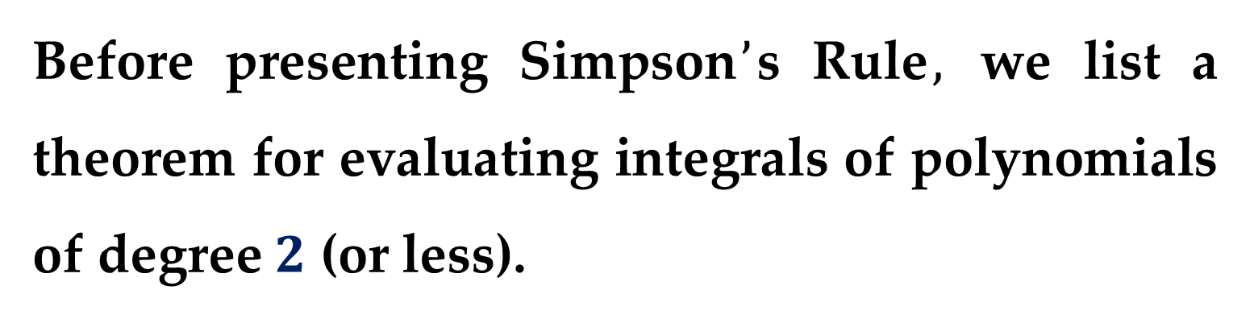
Before presenting Simpson$’$s Rule$,$ we list a theorem for evaluating integrals of polynomials of degree $2$ (or less).
$Theorem 2$. Integral of $p\left(x\right)=Ax^{2}+Bx+C$
If $p\left(x\right)=Ax^{2}+Bx+C,$ then
$$\int_{a}^{b}{p\left(x\right) dx}=\left(\frac{b−a}{6}\right)\left[p\left(a\right)+4 p\left(\frac{a+b}{2}\right)+p\left(b\right)\right]$$

Slide 24
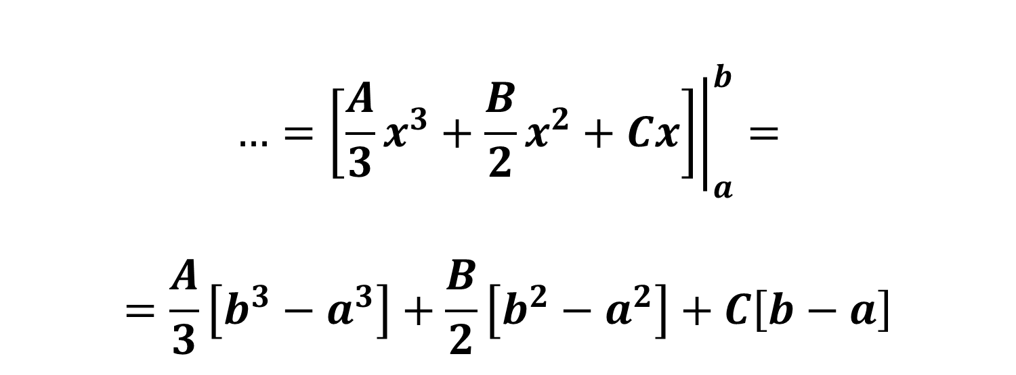
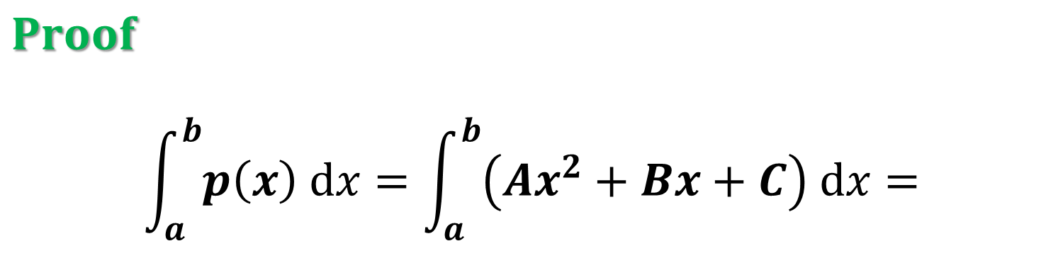
$$Proof$$
$$\int_{a}^{b}{p\left(x\right) dx}=\int_{a}^{b}{\left(Ax^{2}+Bx+C\right) dx}=$$
$$…={\left.\left[\frac{A}{3}x^{3}+\frac{B}{2}x^{2}+Cx\right]\right|}_{a}^{b}=$$
$$=\frac{A}{3}\left[b^{3}−a^{3}\right]+\frac{B}{2}\left[b^{2}−a^{2}\right]+C\left[b−a\right]$$

Slide 25
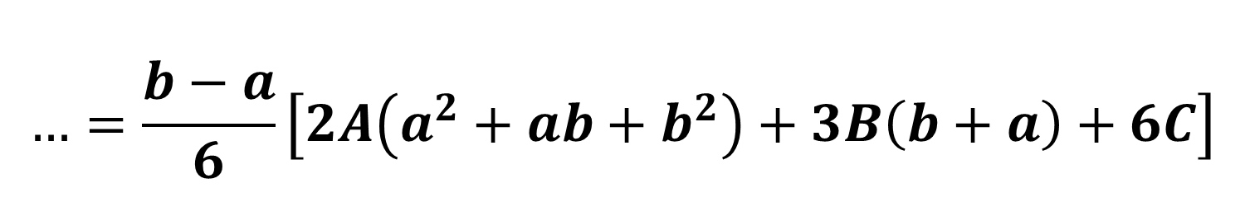
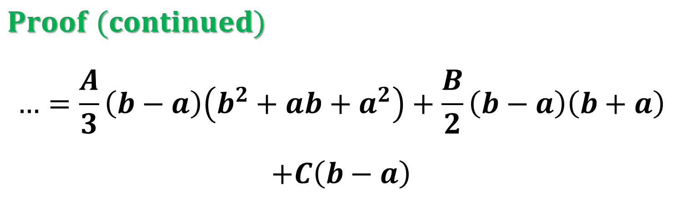
$$Proof (continued)$$
$$…=\frac{A}{3}\left(b−a\right)\left(b^{2}+ab+a^{2}\right)+\frac{B}{2}\left(b−a\right)\left(b+a\right)$$
$$+C\left(b−a\right)$$
$$…=\frac{b−a}{6}\left[2A\left(a^{2}+ab+b^{2}\right)+3B\left(b+a\right)+6C\right]$$

Slide 26
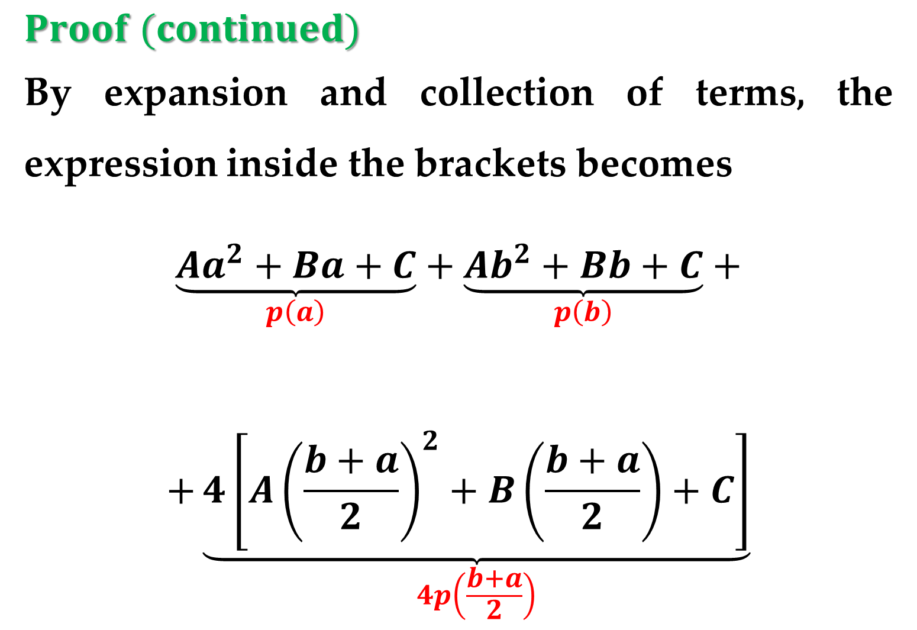
$$Proof (continued)$$
By expansion and collection of terms, the expression inside the brackets becomes
$$\underset{p\left(a\right)}{\underbrace{Aa^{2}+Ba+C}}+\underset{p\left(b\right)}{\underbrace{Ab^{2}+Bb+C}}+$$
$$+\underset{4p\left(\frac{b+a}{2}\right)}{\underbrace{4\left[A{\left(\frac{b+a}{2}\right)}^{2}+B\left(\frac{b+a}{2}\right)+C\right]}}$$

Slide 27
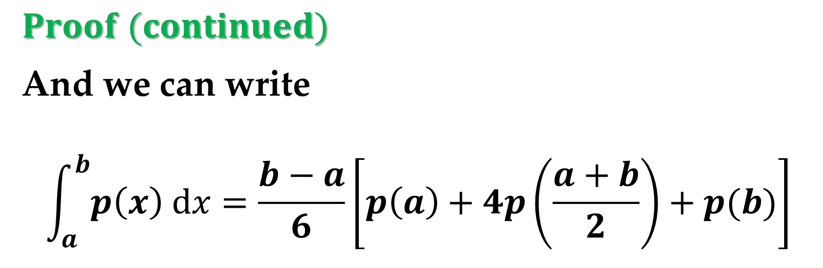
$$Proof (continued)$$
And we can write
$$\int_{a}^{b}{p\left(x\right) dx}=\frac{b−a}{6}\left[p\left(a\right)+4p\left(\frac{a+b}{2}\right)+p(b)\right]$$

Slide 28
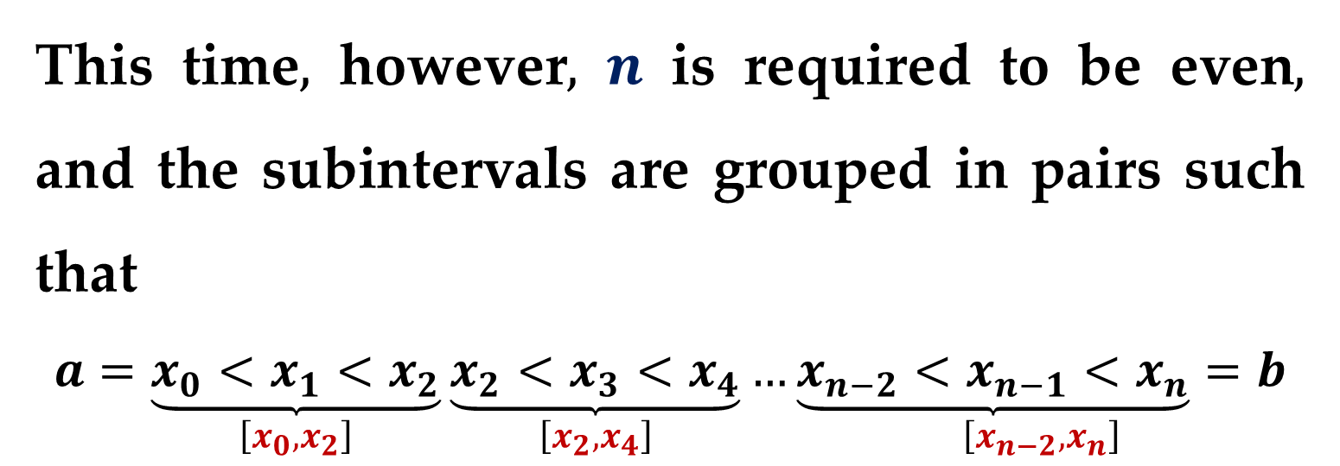
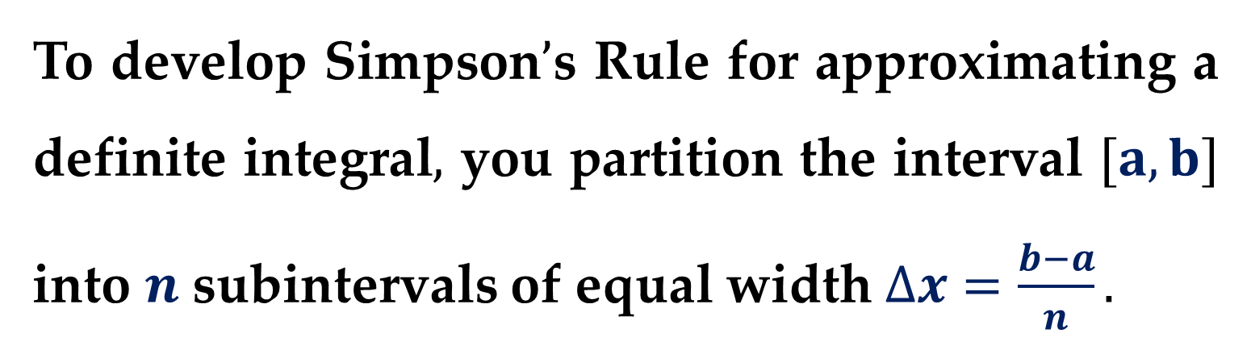
To develop Simpson$’$s Rule for approximating a definite integral$,$ you partition the interval $[a,b]$ into $n$ subintervals of equal width $∆x=\frac{b−a}{n}.$
This time$,$ however$,$ $n$ is required to be even$,$ and the subintervals are grouped in pairs such that
$$a=\underset{\left[x_{0},x_{2}\right]}{\underbrace{x_{0}<x_{1}<x_{2}}}\underset{\left[x_{2},x_{4}\right]}{\underbrace{x_{2}<x_{3}<x_{4}}}…\underset{\left[x_{n−2},x_{n}\right]}{\underbrace{x_{n−2}<x_{n−1}<x_{n}}=b}$$

Slide 29
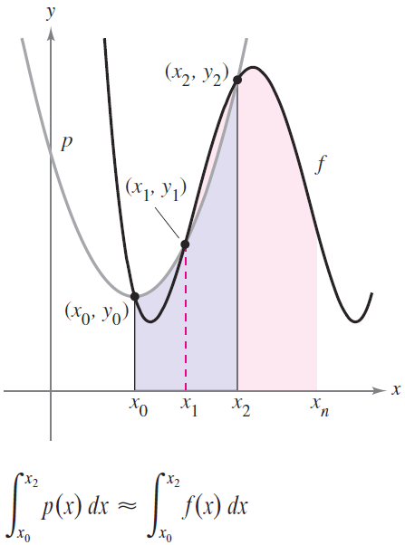
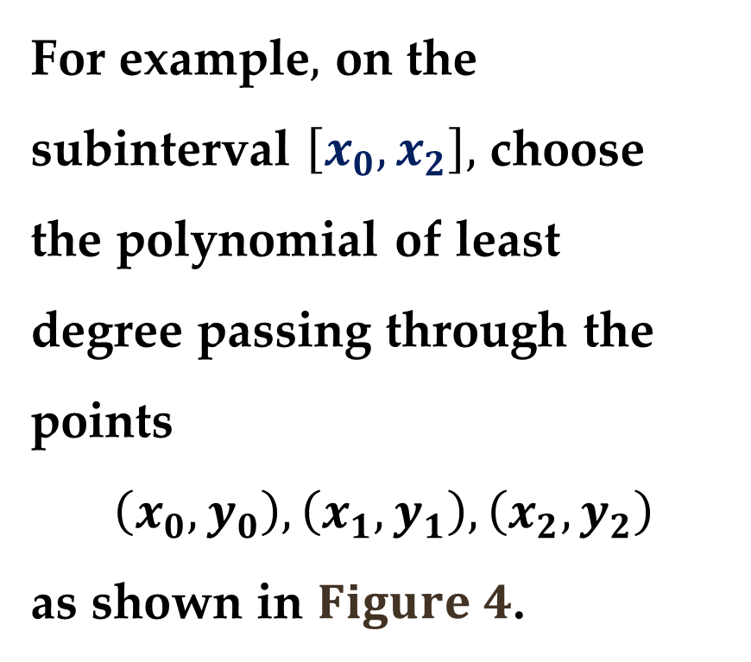
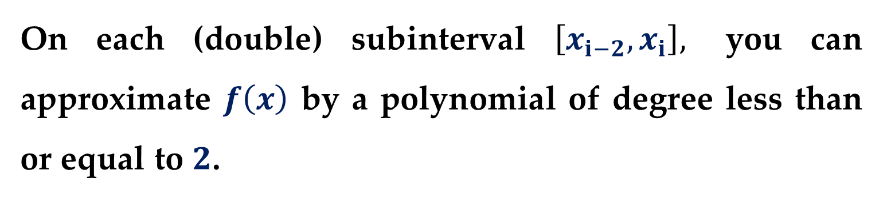
On each (double) subinterval $\left[x_{i−2},x_{i}\right],$ you can approximate $f\left(x\right)$ by a polynomial of degree less than or equal to $2$.
For example$,$ on the subinterval $\left[x_{0},x_{2}\right],$ choose
the polynomial of least
degree passing through the points
$$\left(x_{0},y_{0}\right),\left(x_{1},y_{1}\right),\left(x_{2},y_{2}\right)$$
as shown in $Figure 4$.

Slide 30
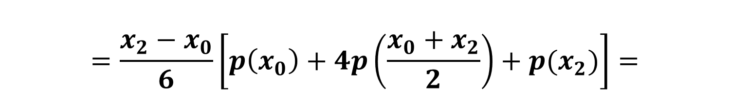



Now$,$ using $p(x)$ as an approximation of $f(x)$ on this subinterval$,$ you have$,$ by $Theorem 2$
$$\int_{x_{0}}^{x_{2}}{f\left(x\right) dx}≈\int_{x_{0}}^{x_{2}}{p\left(x\right) dx}=$$
$$=\frac{x_{2}−x_{0}}{6}\left[p\left(x_{0}\right)+4p\left(\frac{x_{0}+x_{2}}{2}\right)+p(x_{2})\right]=$$
$$=\frac{2\left[\left(b−a\right)/n\right]}{6}\left[p\left(x_{0}\right)+4p\left(x_{1}\right)+p(x_{2})\right]=$$
$$=\frac{b−a}{3n}\left[f\left(x_{0}\right)+4 f\left(x_{1}\right)+f(x_{2})\right]$$

Slide 31


Repeating this procedure on the entire interval $\left[a,b\right]$ leads to the following theorem.
$Theorem 3$. Simpson$’$s Rule
Let $f(x)$ be continuous on $\left[a,b\right]$ and let $n$ be an even integer. Simpson$’$s Rule for approximating the definite integral is
$$\int_{a}^{b}{f\left(x\right) dx}≈\frac{b−a}{3n}\left[f\left(x_{0}\right)+4f\left(x_{1}\right)+2f\left(x_{2}\right)+4f\left(x_{3}\right)+\right.$$
$$\left.+…+4f\left(x_{n−1}\right)+f\left(x_{n}\right)\right]$$

Slide 32



Note
Observe that the coefficients in Simpson$’$s Rule have the following pattern:
$$1 4 2 4 2 4 … 4 2 4 1$$
Example 2. Approximation with Simpson$’$s Rule
Use Simpson$’$s Rule to approximate
$$\int_{0}^{π}{\sin{x}dx}$$
Compare the results for $n=4$ and $n=8$. $∗∗∗$

Slide 33


Integration: Error Analysis
If you have to use an approximation technique$,$ it is important to know how accurate you can expect the approximation to be.
The following theorem (which is listed without proof) gives the formulas for estimating the errors involved in the use of Simpson$’$s Rule and the Trapezoidal Rule.

Slide 34

$Theorem 4$. Errors in Numerical Integration
If $f\left(x\right)$ has a continuous second derivative on $\left[a,b\right],$ then the error $E$ in approximating
$$\int_{a}^{b}{f\left(x\right) dx}$$
by the Trapezoidal Rule is
$$\left|E\right|≤\frac{{\left(b−a\right)}^{3}}{12n^{2}}\left[\max_{a≤x≤b}\left|f′′(x)\right|\right]$$

Slide 35

You can think of the error $E$ as the difference between the exact value of the definite integral
$$\int_{a}^{b}{f\left(x\right) dx}$$
and an approximation.

Slide 36

$Theorem 5$. Errors in Numerical Integration
Moreover, if $f\left(x\right)$ has a continuous fourth derivative on $\left[a,b\right],$then the error $E$in approximating the integral
$$\int_{a}^{b}{f\left(x\right) dx}$$
by Simpson$’$s Rule is
$$\left|E\right|≤\frac{{\left(b−a\right)}^{5}}{180n^{4}}\left[\max_{a≤x≤b}\left|f^{\left(4\right)}(x)\right|\right]$$

Slide 37


$Theorems 4$ and $5$ state that the errors generated by the Trapezoidal and Simpson’s rules have upper bounds dependent on the extreme values of the derivatives of $f\left(x\right)$ in the interval $\left[a,b\right]$.
Furthermore, these errors can be made arbitrarily small by increasing $n,$ provided that $f′′$and $f^{\left(4\right)}$are continuous and therefore bounded in $\left[a,b\right]$.

Slide 38

$Example 3$. The Approximate Error in the
Trapezoidal Rule
Determine a value of $n$ such that the Trapezoidal Rule will approximate the value of
$$\int_{0}^{1}{\sqrt{1+x^{2}} dx}$$
with an error that is less than or equal to $0.01$.
$$∗∗∗$$

Slide 39

$$\int_{0}^{1}{\sqrt{1+x^{2}} dx}$$
$$f\left(x\right)=\sqrt{1+x^{2}}$$
$$f^{′}\left(x\right)={\left[\sqrt{1+x^{2}}\right]}^{′}=\frac{x}{\sqrt{1+x^{2}}}$$
$$f^{′′}\left(x\right)={\left[\frac{x}{\sqrt{1+x^{2}}}\right]}^{′}=\frac{1}{{\left(1+x^{2}\right)}^{3/2}}$$

Slide 40

$$f^{′′}\left(x\right)=\frac{1}{{\left(1+x^{2}\right)}^{3/2}}$$
$$\max_{\left[0,1\right]}\left|\frac{1}{{\left(1+x^{2}\right)}^{\frac{3}{2}}}\right|=1$$
$$\frac{1}{100}=\frac{1}{12n^{2}}→n^{2}=\frac{100}{12}=8.3333→$$
$$n=\sqrt{8.3333}=3$$

Slide 41

$Adaptive Techniques of Integration$
A variation on the numerical integration methods described so far is $adaptive$ $quadrature,$ in which the algorithm detects areas where its approximation method may produce large errors and refines its method in those areas.

Slide 42




For example$,$ look at $Figure 5$.
In areas where the curve is close to straight$,$ the trapezoids approximate the curve very closely.
In areas where the curve is bending sharply$,$ the trapezoids do not fit as well.

Slide 43

An algorithm of adaptive quadrature looks for areas where the trapezoids do not fit the curve well and uses more trapezoids in those areas.
The $Adaptive_Midpoint_Integration$ algorithm uses the trapezoid rule with adaptive quadrature.
When calculating the area of a slice, the program uses a single trapezoid to approximate its area.

Slide 44

It then breaks the slice into two pieces and uses two smaller trapezoids to calculate their areas.
If the difference between the larger trapezoid$’$s area and the sum of the areas of the smaller trapezoids is more than a certain percentage$,$ the program divides the slice into two pieces and calculates the areas of the pieces in the same way (in a recursive manner).

Slide 45

$Example 4$.
Develop the Adaptive_Midpoint_Integration program to calculate the definite integral
$$\int_{0}^{5}{\left(1+x+\sin{2x}\right) dx}$$
and start with only two initial slices.
Estimate the area under the curve with $0.035\%$error.

Slide 46

$$\int_{0}^{5}{\left(1+x+\sin{2x}\right) dx}=\left[x+\frac{x^{2}}{2}−\frac{1}{2}\cos{2x}\right]{\left.​\right|}_{0}^{5}=$$
$$=\left[5+\frac{5^{2}}{2}−\frac{1}{2}\cos{10}\right]−\left[0+\frac{0^{2}}{2}−\frac{1}{2}\cos{0}\right]=$$
$$=5+12.5−\left(−0.4195\right)+0.5=$$
$$=18.4195$$

Slide 47


$Example 4$. (continued)
If you use the Trapezoid Rule algorithm with $24$ slices of uniform width$,$ the algorithm will have an error of $0.072\%,$ roughly twice as much as that produced by the adaptive algorithm.
The two algorithms use the same number of slices$,$ but the adaptive algorithm positions them more effectively.

Slide 48


The $Adaptive_Trapezoid_Integration$ algorithm uses a different method to decide when to break a slice into sub-slices.
It calculates the second derivative of the function at the slice’s starting $x$ value and divides the interval into one slice plus $1$ per second derivative value.

Slide 49

For example, if the second derivative is approximately $2$, the program divides the slice into three pieces. (The formula for the number of slices was chosen somewhat arbitrarily.)
Note
A function’s derivative tells you its slope at any given point.
Its second derivative tells you the slope’s rate of change, or how fast the curve is bending.

Slide 50
Note
A higher second derivative means that the curve is bending relatively tightly, so the Adaptive_Trapezoid_Integration algorithm uses more slices.
Of course, this technique will not work if you cannot calculate the curve’s second derivative.

Slide 51

Implications
Adaptive techniques are useful in many algorithms because they can produce better results without wasting effort in areas where it is not needed.
The $Adaptive_Grid_Integration$ algorithm described below uses adaptive techniques to estimate the area in a shaded region.

Slide 52


As shown in $Figure 6,$ this region includes the union of vertical and horizontal ellipses, minus the areas covered by the three circles inside the ellipses.
This algorithm divides the whole image into a single box and defines a grid of points inside the box.

Slide 53

In $Figure 6$ the algorithm uses a grid with four rows and columns of points.
For each point in the grid, the algorithm determines whether the point lies inside or outside the shaded region.
If none of the points in the box lies within the shaded region, the algorithm assumes the box is not inside the region and ignores it.

Slide 54
If every point in the box lies inside the shaded region, the algorithm considers the box to lie completely within the region and adds the box’s area to the region’s estimated area.
If some of the points in the box lie inside the shaded region and some lie outside the region, the algorithm subdivides the box into smaller boxes and uses the same technique to calculate the smaller boxes’ areas.

Slide 55

$Monte Carlo integration$ is a form of numeric integration in which the program generates a series of pseudorandom points uniformly within an area and determines whether each point lies within the target region.
When it has finished, the program uses the percentage of the points that were inside the region to estimate the region’s total area.

Slide 56


For instance, suppose the area within which the points are generated is a $20×20$ square, so it has an area of $400$ square units, and $37\%$ of the pseudorandom points are within the region.
The region has an area of roughly
$$0.37 × 400 = 148$$
square units.

Slide 57
Monte Carlo integration generally is more prone to error than more methodical approaches such as trapezoid integration and adaptive integration.
But sometimes it is easier because it does not require you to know much about the nature of the shape you are measuring.
You just throw points at the shape and see how many hit it.

Slide 58


$Figure 7$: Points inside the shaded region are black$,$ and points outside the region are gray.
More generally, using pseudorandom values, you can use similar techniques to solve many problems.

Slide 59
Thank you for attention

